Slide 1
PRTF Census-Snapshot in Time
September 2011
June 2017
In state | 386
Border | 25
Out | 30
Total | 431
In state | 533
Border | 162
Out | 32
Total | 727

Slide 2
PRTF Average and Median Lengths of Stay 2017
Average LOS 1 | Average LOS 2 | Median LOS 1 | Median LOS 2
171 | 140 | 157 | 123

Slide 3
Child MH and SA Services SFY17
Medicaid, MHBG, and State Funds
Medicaid Encounter Data from CCNC and Paid NCTracks Data through October 2017

Slide 4
Child MH and SA Services SFY17
Medicaid, MHBG, and State Funds
Medicaid Encounter Data from CCNC and Paid NCTracks Data through October 2017

Slide 5
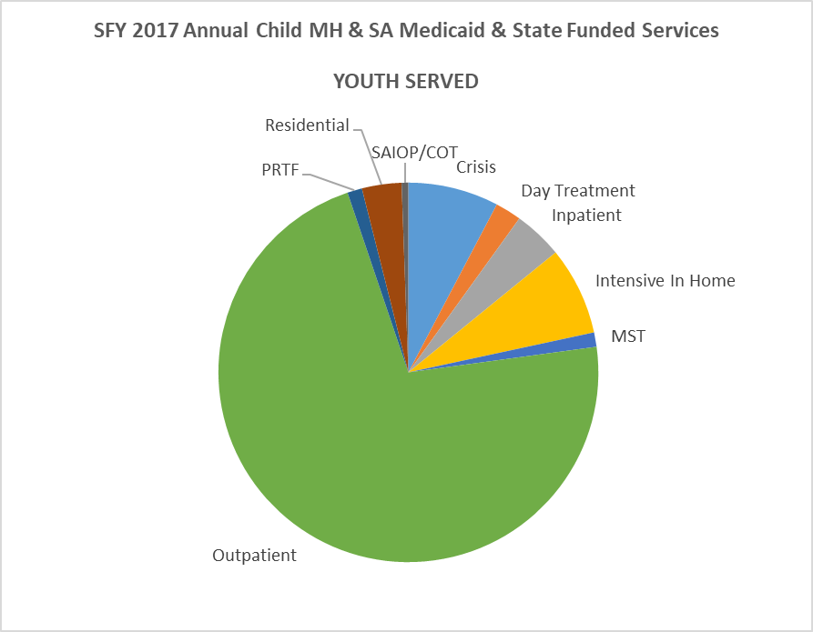
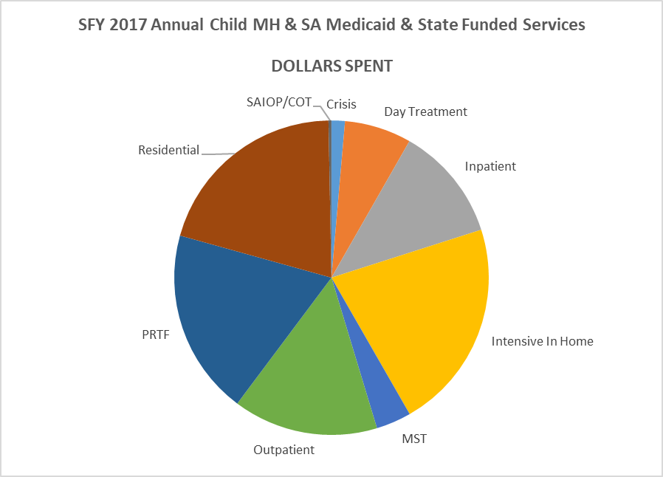
Child MH and SA Services SFY17
Medicaid Encounter Data from CCNC and Paid NCTracks Data through October 2017

Slide 6
Six Core Strategies: Prevention of Restraint and Seclusion
Leadership
Use of data to inform practice
Workforce development
Use of seclusion and restraint prevention tools
Youth and family voice/choice/roles
Debriefing techniques

Slide 7
Six Core Strategies
Target Audience: PRTFs, Child Facility Based Crisis Services, State Adolescent Psychiatric Units
May 21-22 Kick-Off Training
Year of conference calls/webinars for targeted programs
3-5 facilities can apply for site visits and additional consultation
Consultation to a State Team
State Team develops recommendations to align policy

Slide 8
Building Bridges Initiative
Best Practices in Child Residential
Strengthening ties between residential intervention, family, and community
Move from control/coercion to collaboration
Increased youth and family voice, choice, roles, and engagement

