Slide 1
North Carolina School Mental Health Initiative (NCSMHI)
Fall, 2017, Updates
Notes:
This brief webinar will provide an overview of the State Board of Education approved school mental health policy and plans to support the implementation of this policy in order to support equitable access to school mental health supports and services for all students in NC public schools.

Slide 2
Today’s Topics
Background of NC School Mental Health Initiative (NC SMHI)
State Board of Education Policy – SHLT-003
Relevant legislation
Plans to support implementation of SHLT-003
Notes:
Webinar topics covered include:
Brief history of the North Carolina School Mental Health Initiative
Overview of the State Board of Education policy – approved in April 2017
Discuss relevant legislation that aligns with this policy
Review the steps that the Department of Public Instruction will take to support districts and schools in their implementation of the policy

Slide 3
NC SMHI Mission
It is the mission of this partnership to provide implementation and monitoring support to ensure that public school students in North Carolina have equitable access to a full continuum of high-quality and well-coordinated socio-emotional/behavioral health services.
NC School Mental Health Initiative Recommendations, Fall 2016
Notes:
This partnership, consisting of over 100 stakeholders from across the state, has met bi-monthly since June 2015 in order to:
Gather existing and additional information/data regarding the status of mental health in children and youth, at both the national and state level
Synthesize information in a variety of formats, including:
A detailed full report of the background, findings and recommendations
An executive summary to communicate the main points of the full report
A summary document reflecting the final recommendations of the partnership
The recommendations made by the NC SMHI led to the development of a policy proposal to support students’ in NC public schools access to, and benefit from, adequate mental health education, prevention, and intervention services.
The policy proposal was presented and discussed within the State Board of Education meetings in February and March of 2017 and returned for approval in April 2017

Slide 4
Family-School-Community Partnership:
Multi-disciplinary, diverse group:
Parents
Public school representatives (LEA and SEA)
State agency officials (DHHS,DPS, DPI)
Community-based mental health providers
Attorneys and advocates
Third-party payors
University faculty
Professional associations
Other interagency collaboratives
Notes:
Ginny and Corye
At the beginning of this slide, ask all of the SMHI representatives to stand.
The SMHI represents a large group of stakeholders from diverse backgrounds and experiences related to the provision of mental health services to youth
WHO WE ARE:
Parents
8 LEAs selected for diversity in size/demographics
DHHS:
Div. of Mental Health
Div. of Public Health
Div. Social Services
Div. Medical Assistance
NC Department of Public Instruction:
K-12 Standards, Curriculum, and Instruction Division
Healthy Schools Division
Exceptional Children Division
Safe and Healthy Schools Support Division
State agency officials (DHHS,DPS, DPI)
Community-based mental health providers
Hospitals/Healthcare Systems
Managed Care Organizations
Individual Community mental health practitioners
Attorneys and Advocates
NC Families United
Disability Rights NC
Exceptional Children Assistance Center
National Alliance on Mental Illness
Duke Law Clinic
NC Council for the Deaf and Hard of Hearing
Third-party payors
BCBS
University faculty
East Carolina Univ.
Appalachian State Univ.
UNC Chapel Hill
UNC Greensboro
Professional associations
NC Association of School Psychologists
NC Association of School Counselors
NC Association of School Nurses
NC Association of Occupational Therapists
Other Agency Collaboratives:
Cross Agency Collaborative
Infant Mental Health Task Force
Commission on Children With Special Health Care Needs – Behavioral Health Work Group
Governor’s Task Force on Mental Health and Substance Abuse

Slide 5
Integrating Services in Schools
Access to school-based mental health services is linked to:
Improved academic outcomes
Enhanced physical and psychological safety
Michael, et al., 2013; Ballard, Sander, & Kilmes-Dougan, 2014
Notes:
Ginny and Corye
With the charge to holistically meet the needs of the whole child, including prevention of mental health problems, the school is the logical place to integrate services to promote equitable access.
From our environmental scan, we found that families are currently struggling to navigate the system and connect to the services they need.
For example:
26% of parent responders stated that transportation issues have prevented them from accessing mental health services for their child.
60% of parents believe that some children get better access to community-based services than others
As we discuss inequitable access, it is incumbent for us to do so in the context of the second leading cause of death among people aged 10-24 years - suicide. Equitable access to high quality mental health services can save the lives of children and youth in NC.
75% of students with a mental health disorder do not access mental health services. We know we can do better, and we know integration of mental health in schools can improve access. Consider stating this in terms of raw numbers (~227,000).

Slide 6
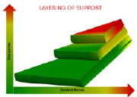
NC SMHI Recommendations
What:
Create a Continuum of Supports and Services
How:
Make it Sustainable
Who:
Engage Stakeholders
Notes:
Ginny and Corye
Our recommendations are organized into three primary domains describing:
What we propose to do
How it can be made sustainable within the context of North Carolina
Who would be involved with and benefit from the work
The recommendation development process happened systematically with the SMHI mission in mind. The recommendations are structured in such a way so they are actionable and readily translatable to policy statements.

Slide 7
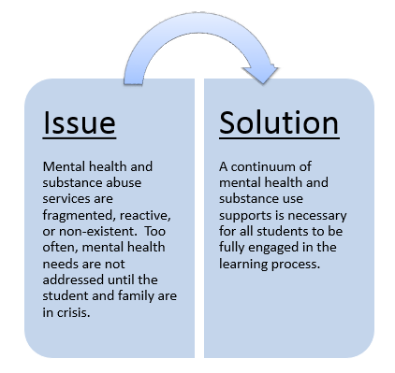
Create a Continuum
Notes:
David
The first recommendation involves the creation of a seamless continuum of supports and services that are integrated within the school setting and occur within the community.
Currently, the provision of mental health services is reactive and costly. Many of the mental health problems students experience could be prevented with high quality core behavioral programming in the context of trauma-informed healthy school communities. If enacted well, these policy recommendations would yield a high return on investment by preventing the costs associated with students and families experiencing high intensity mental health needs.

Slide 8
Layering of Integrated Support
COMMUNITY-BASED
RESOURCES
INTENSIVE
SUPPLEMENTAL
UNIVERSAL
SCHOOL-BASED
STUDENT NEED
Notes:
David
The recommendations have been crafted to align to a multi-tiered system of support (MTSS). NC MTSS is a multi-tiered framework which promotes school improvement through engaging, research-based academic and behavioral practices. NC DPI believes that MTSS is the most effective and efficient approach to improving school outcomes and student performance thereby ensuring equitable access to a sound basic education.
As noted here, the continuum of supports is conceptualized as layers of support. All students access universal supports that include attending schools in which educators are adequately trained and prepared to recognize and address mental health needs, the stigma of mental health is diminished, and the school community fosters a positive climate that promotes the infusion of social-emotional learning and resilience building.
In addition, this graphic demonstrates the integration and seamless access to services across the continuums of student need and school or community based.
These are brief bullets describing the implementation strategies for creating a continuum.
Payors include schools, families, community providers, MCOs among others.
Universal screening is necessary for early identification and prevention, particularly for students experiencing internalizing problems that are rarely recognized by school staff. We need to have some discussion around how we will talk about this at our planning meeting. Some notes:
At the secondary level, some of this could be done with existing data sources through the development of an early warning system in ECATS
Screening data do not diagnose mental health disorders or yield a “psychological profile” of any sort
Screening would only occur with consent (likely passive consent in which all families would have the opportunity to opt out)
Supports or services that occur as a result of screening would only occur with active consent
All payors will jointly create a plan for meeting the mental health and substance use needs of all NC public school children. The continuum will be provided within the context of a multi-tiered system of supports (MTSS) and will include:
Education of staff and students pre-k – 12
Promotion of healthy school communities
Universal screening
Supplemental supports
Intensive services for students and families
To ensure accountability, the plan will include a system to evaluate the quality of mental health services and measure student outcomes

Slide 9
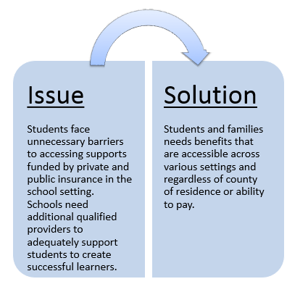
Make It Sustainable
Notes:
Ann
Summarize the issues and solution for this recommendation.
We may want to provide some update / thinking in regard to the Medicaid expansion and the discussion with BCBS.
*Also emphasize the language around the sufficient resources related to Specialized Instructional Support Personnel (SISP) – making the case that the current infrastructure is not sufficient. Positions include school psychology, school counselors, school social workers, school nurses. This is not “add on” services. These are essential services for academic growth.
Data from the environmental scan related to school personnel:
80% of school respondents did not feel that schools possess adequate personnel to provide a full range of services promoting social-emotional well being
81% of parents did not feel school possess enough people to effectively help students with social emotional health needs
Employ in sufficient numbers, adequately trained and licensed Specialized Instructional Support Personnel (SISP) (school counselors, school nurses, school psychologists, school social workers)
Ensure state level infrastructure exists to provide consistent and cohesive support to Specialized Instructional Support Personnel
Blend existing funding streams to create devoted full-time mental health positions in LEAs that are designed to work within school districts and between community systems of care
Make mental health and substance use a required component of professional development for all school staff and boards of education.

Slide 10
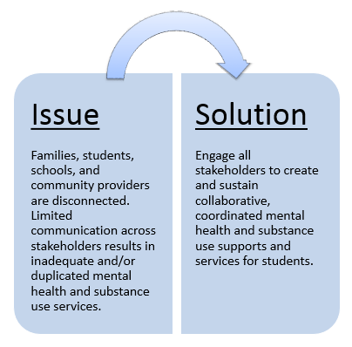
Engage Stakeholders
Notes:
Mark
Must include a strong parent and student voice, as well as others that oversee funding.
Stakeholders must be reflective of your community.
This includes connections with the local community collaborative – empowering them to coordinate with providers / community stakeholders.
Dedicate school resources to build partnerships with families and community mental health and substance use providers
Map and communicate local mental health and substance use supports and services for students, including providers
Simplify family/student access to community mental health and substance use supports and services
Remove barriers to the exchange of information across schools, families, and agencies

Slide 11
SBE Policy – SHLT-003
Item | Description
Policy Title | School-Based Mental Health Initiative
Policy Category | Student Health Issues (SHLT)
Policy ID | SHLT-003
Policy Date | 2017-04-07
Notes:
Here is the policy reference from SBE Policy Manual
Category is Student Health Issues
Policy ID is SHLT-003
Approved on April 7, 2017

Slide 12
SBE Policy - SHLT-003
Purpose: improve the effectiveness of supports for NC public school students’ mental health and substance use needs
Requirements:
a plan for every NC public school system and charter school to develop/improve a full range of mental health and substance use services, including: (i) universal prevention; (ii) early intervention services; and (iii) referral, treatment, and re-entry support
coordination of mental health and substance use services between schools, families, and community providers
mental health and substance use training for school staff
NC Department of Public instruction (NCDPI) support to schools for statewide training, guidance, technical assistance, and materials
Notes:
Summary of the policy requirements:
a plan for every NC public school system and charter school to develop/improve a full range of mental health and substance use services that will include:
universal prevention;
early intervention services;
referral, treatment, and re-entry support
​coordination of mental health and substance use services between schools, families, and community providers
​mental health and substance use training for school staff
​NC Department of Public instruction support to schools for statewide training, guidance, technical assistance, and materials at no cost
​implementation for traditional public schools SY 2018-19 and for charter schools SY 2019-20
Implementation for traditional public schools SY 2019-20 and for charter schools SY 2020-21*

Slide 13
Recent Legislation
SL-2017-157:
PART IV. SUPERINTENDENT STUDY STUDENT HEALTH ISSUES SECTION 4.(a)
PART V. STATE BOARD OF EDUCATION INTERAGENCY ADVISORY COMMITTEE AND SCHOOL-BASED MENTAL HEALTH INITIATIVE DELAY IMPLEMENTATION SECTION 5.(a)
Notes:
SL 157 OMNIBUS EDUCATION ACT
PART IV. SUPERINTENDENT STUDY STUDENT HEALTH ISSUES
SECTION 4.(a) The Superintendent of Public Instruction shall convene a work group to study effective and positive intervention measures or policy changes to address risky behaviors and encourage student health and mental health. The work group shall consist of personnel from within the Department of Public Instruction with expertise in student health issues, including mental health, as well as personnel from the Department of Health and Human Services, Division of Public Health. The Superintendent may also appoint representatives from various public and private stakeholder groups as well as representatives from local school administrative units and charter schools. The Superintendent shall report on the work group's findings and recommendations to the State Board of Education and the Joint Legislative Education Oversight Committee by April 1, 2018.
PART V. STATE BOARD OF EDUCATION INTERAGENCY ADVISORY COMMITTEE AND SCHOOL-BASED MENTAL HEALTH INITIATIVE DELAY IMPLEMENTATION
SECTION 5.(a) The State Board of Education shall not adopt or implement any policies or recommendations from the Interagency Advisory Committee established by the State Board of Education in Policy ADVS-009 until October 1, 2018.
SECTION 5.(b) The State Board of Education shall change the timelines for the development and implementation of plans and training required by Policy SHLT-003 regarding school-based student mental health initiatives as follows for local school administrative units: (i) development of the plans to assess mental health and substance use needs shall occur during the 2018-2019 school year; (ii) the implementation plan and three-year review cycle shall commence in the 2019-2020 school year; and (iii) school mental health training will be provided by the Department of Public Instruction to the local school administrative units during the 2019-2020 school year. The State Board of Education shall change the timelines for the development and implementation of plans and training required by Policy SHLT-003 regarding school-based student mental health initiatives as follows for charter schools: (i) development of the plans to assess mental health and substance use needs shall occur during the 2019-2020 school year; (ii) the implementation plan and three-year review cycle shall commence in the 2020-2021 school year; and (iii) school mental health training will be provided by the Department of Public Instruction to charter schools during the 2020-2021 school year.
SECTION 5.(c) The State Board of Education shall provide notice to local school administrative units participating in the "Whole School, Whole Community, Whole Child" pilot program regarding Parts IV and V of this act and shall allow the units to withdraw from the pilot program at their discretion.

Slide 14
Cross-State School Mental Health Collaborative
NC 1 of 9 states selected to join National Coalition for the State Advancement of School Mental Health (NCSA-SMH)
NC LEAs invited to complete School Health Assessment and Performance Evaluation (SHAPE) System, www.theshapesystem.com
Join, register, and complete:
School Mental Health Profile, and
School Mental Health Quality Assessment
Notes:
(NCSA-SMH), a technical assistance opportunity hosted by the national Center for School Mental Health at the University of Maryland to improve statewide capacity to address student social and emotional needs and school climate.
SHAPE is funded in part by the US Department of Health and Human Services and is designed to improve school mental health accountability, excellence, and sustainability nationwide.
powerful resource for districts to ensure consistent, high-quality, multi-tiered school mental health services and supports. SHAPE also offers districts a uniform quality improvement process to understand school mental health strengths and needs. SHAPE can help you standardize the process of school-community partnerships in your district and advance data-driven decision making not only for your district, but also your individual schools if you choose. Finally, SHAPE is not just a data “submission” portal, but instead provides numerous customized reports and resources to support your strategic action planning related to school mental health quality and sustainability.
Have the team complete following online questionnaires about school mental health in your district:
School Mental Health Profile, and
School Mental Health Quality Assessment or Sustainability Assessment
After completing these steps, you will have access to free custom reports about your district’s school mental health system and an entire repository of resources to support your school mental health efforts!

Slide 15
NC Investment in NCSA-SMH
PHASE I - At least one LEA or charter school in each of NC’s eight regional education districts complete NSMH Census and Quality Measure by October 1, for a total of eight SHAPE Silver Star status LEAs/charter schools
PHASE II:
20% of traditional LEAs (23), complete census and quality measure by July 1, 2018
20% of charter schools (33) complete census and quality measure by July 1, 2019

Slide 16
How Does SHAPE Enhance and Align with MTSS Implementation?
Helps identify what services exist for specific problem areas across a multi-tiered system of support (MTSS)
Adds value and specificity to current MTSS behavioral resources
Provides diagnostic tool for school mental health “health”
Locates where to begin or improve universal screening practices

Slide 17
Next Steps
August, 2017 - Identify 8 pilot LEAs/charter schools to complete 2 SHAPE components and begin accessing resources
October, 2017 – Pilots complete SHAPE components
Winter, 2018 – begin statewide SHAPE enrollment; develop resources for 2018 LEA planning
Spring, 2018 – report on pilot LEA findings
Summer, 2018 – launch resources for LEA planning
SY 2018-19 – traditional LEAs develop plan
SY 2019-20 – charters develop plan

Slide 18
Technical Assistance
In NC:
lauren_holahan@med.unc.edu or lkmakor@email.unc.edu
National Center for School Mental Health
csmh@som.umaryland.edu; or
Sharon Hoover, PhD: shoover@som.umaryland.edu
Notes:
NC SMHI/DPI support
SHAPE is hosted by the Center for School Mental Health, and by virtue of NCDPI’s participation in the National Coalition for the State Advancement of School Mental Health (NCSA-SMH), the Center’s faculty is available to directly provide any technical assistance or support you might need

